Slide 1
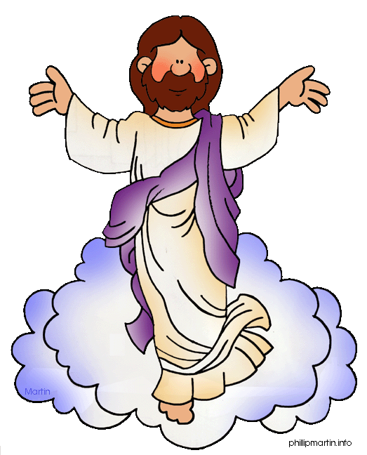
Celebrating Easter in Family
Av. Santa Cruz 5400, Vitacura | Santiago de Chile www.saintgeorge.cl

Slide 2
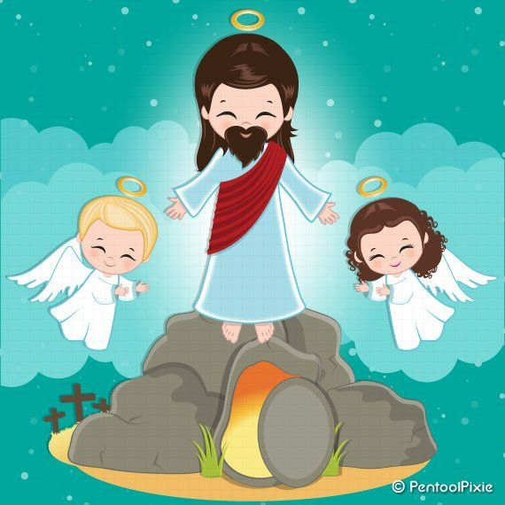
What do we celebrate in Easter?
In Easter, we celebrate the resurrection of our Lord Jesus Christ. We commemorate his passion and death. We remember that Jesus died for us, to clean ourselves from sin and as the ultimate act of love.
He sacrificed himself for us to see how merciful and loving is God.
Av. Santa Cruz 5400, Vitacura | Santiago de Chile www.saintgeorge.cl

Slide 3
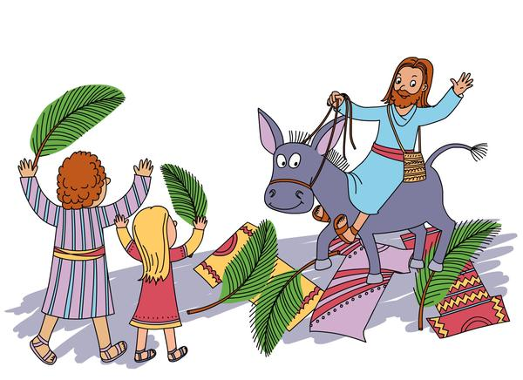
Palm Sunday
Jesus entered triumphantly to the city of Jerusalem in the back of a mule. People gathered to greet him with chants, palm tree leaves and rejoice.
What symbol do we receive in mass to honor this day?
How did you celebrate this event last Sunday?
Av. Santa Cruz 5400, Vitacura | Santiago de Chile www.saintgeorge.cl

Slide 4
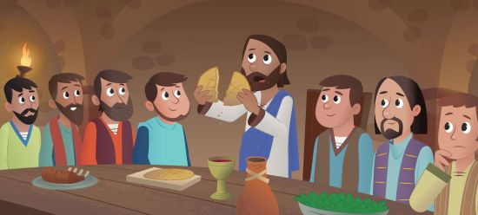
The Last Supper- Holy Thursday
Jesus and his disciples sat together in one big room. As they ate, Jesus spoke to the disciples. He told them he was looking forward to his Passover Feast that he wanted to share with them.
Jesus took a loaf of bread, thanked to the Lord for it, and gave it to his disciples and said, “This loaf of bread is my body”. Jesus then picked up the cup of wine and once again, thanked the Lord for the same. Offering them the wine, he said, “This cup of wine is my blood?
How do we remember this holy celebration? How many times do you participate of this celebration in the year?
Av. Santa Cruz 5400, Vitacura | Santiago de Chile www.saintgeorge.cl

Slide 5
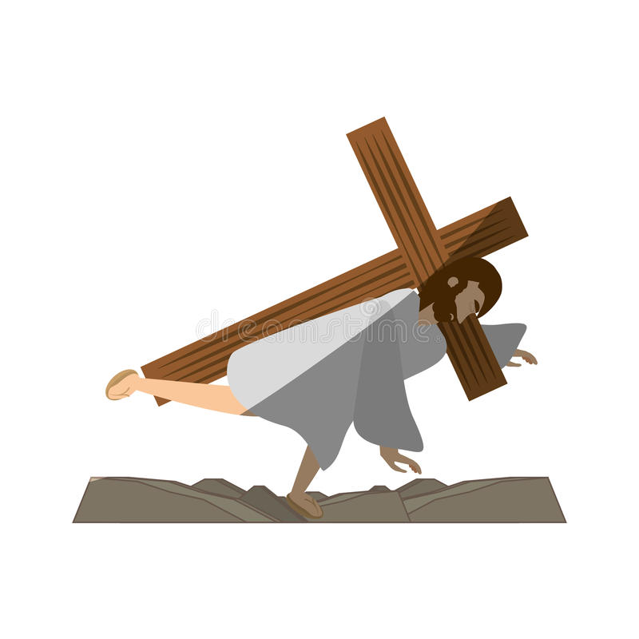
Holy Friday- Via Crucis
Jesus was arrested because of blasphemy, because the Jews accused him of saying “He was the king of kings”. He was judged by Pontius Pilates who saw that Jesus didn’t do something wrong and couldn`t judge him, so he washed his hands and left the decision to the people in town.
People shouted: “Crucify him!”. The same people who greeted him in his entry to Jerusalem, betrayed him and sent him to his death. He was tortured and obliged to carry his cross to a place called Golgotha where he was crucified. He died saying: “Eloi, Eloi, lema sabachthani?” that means “My God, my God, why have you forsaken me?”
Why do you think Jesus said: “My God, my God, why have you forsaken me?” when he died?
Av. Santa Cruz 5400, Vitacura | Santiago de Chile www.saintgeorge.cl

Slide 6
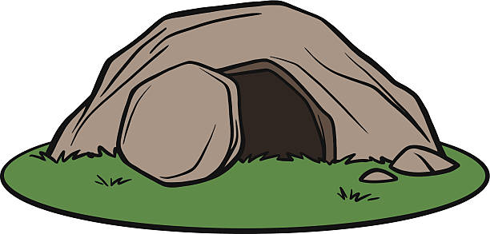
Holy Saturday
Before Sabbath, Joseph of Arimathea, asked Pontius Pilates for the body of Jesus. He took down the body from the cross, wrapped it in linen cloth, and placed it in a tomb cut out of rock. Then, he closed the tomb with a big stone. Mary Magdalene and Mary, the mother of Joseph, saw where he was laid.
On Holy Saturday, we reflect on Jesus’ sacrifice and wait for his resurrection.
Reflect in family, what was Jesus’ biggest saccrifice?
How do we thank his sacrifice?
Av. Santa Cruz 5400, Vitacura | Santiago de Chile www.saintgeorge.cl

Slide 7
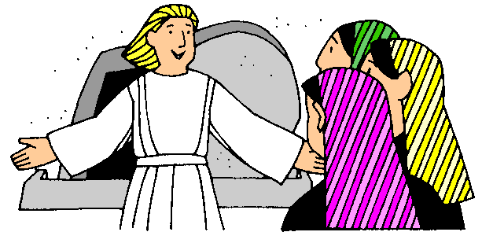
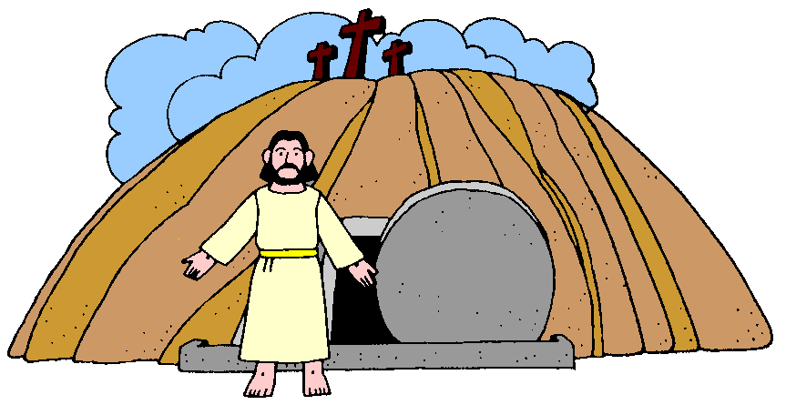
Holy Sunday- Resurrection
After Sabbath, Mary Magdalene, Mary the mother of James, and Salome went to Jesus’ tomb. They found the tomb opened and a man dressed in white inside (an angel sent by God).
The angel said: “Don’t be alarmed! You are looking for Jesus the Nazarene, who was crucified. He has risen! He is not here”. He told them to tell his disciples and they did.
Then in time, Jesus presented himself to Mary Magdalene who told the others that Jesus is alive! The disciples didn’t believe her. Later, Jesus himself went to see them. He showed them his wounds and told them: “Go into all the world and preach the gospel to all creation”. He asked them to baptize others and spread the Good News!
Av. Santa Cruz 5400, Vitacura | Santiago de Chile www.saintgeorge.cl

Slide 8
Let’s pray together!
O Lord, How amazing is your love, A love that overcomes, endures and redeems. How astounding is your life, A life that sustains, heals and creates. How awesome is your hope, A hope that promises, restores and inspires. How absorbing is your truth, A truth that releases, changes and rebuilds. How we worship you, as we remember the moment when your love conquered. When out of the cave of sorrow Jesus arose to release forgiveness to the world. And each time we encounter this resurrection day we are again lifted to an eternal place. Our sin, brokenness and darkness fall away and your light and peace flood our lives. How we thank you for this incredible celebration we call Easter. Amen.
Read more: https://www.living-prayers.com/events/easter_prayers.html#ixzz6ISVT34rs
Av. Santa Cruz 5400, Vitacura | Santiago de Chile www.saintgeorge.cl

